Slide 1

Agency Performance Analysis
CPEE Final Project Batch 21
Pratik Goyal
Feb 25 , 2017

Slide 2

Introduction
Problem Statement
Domain Details
Dataset
Data Preparation
Algorithms Considered
Important features
Results
Performance Matrix
Conclusion
Future scope

Slide 3

Introduction
The Azure Insurance Group, consists of 10 property and casualty insurance, life insurance and insurance brokerage companies. The property and casualty companies in the group operate in a 17-state region. Mutual group is a major regional property and casualty insurer, represented by more than 4,000 independent agents who live and work in local communities through a six-state region. Define the metrics to analyze agent performance based on several attributes like demography, products sold, new business, etc. Azure is interested in improving their existing knowledge used for agent segmentation in a supervised predictive framework

Slide 4
Problem Statement
The Azure Insurance Company operates through various agencies to sell their insurance product. Each agency’s performance is measured in terms of growth rate. Through this project we determine the important factors leads to change in growth rate of the agency

Slide 5
Domain Details
Insurance companies create value by pooling and redistributing various types of risk. It does this by collecting liabilities (i.e. premiums) from everyone that it insures and then paying them out to the few that actually need them. The insurance company can then effectively redistribute those liabilities to entities faced with some sort of event-driven crisis, where they will ostensibly need more cash than they currently have on hand. As not everyone within the pool will actually suffer an event requiring the total use of all of their premiums, this pooling and redistribution function lowers the total cost of risk management for everyone in the pool.
Insurance companies theoretically make money in two ways:-
By charging enough premiums to cover the expected payouts that they will have to cover over the life of the policy
By earning investment returns ("the float") using the collected premiums

Slide 6
Duties of Insurance Agents:
Insurance agents work for insurance providers and try to sell new policies or renewals to customers
Educate Your Clients.
Be a Consultant.
Be Thorough.
Seek New Clients

Slide 7
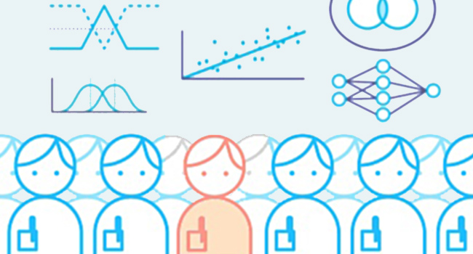
Features selection Algorithms
Random Forest
Auto encoders
Singular Value Decomposition

Slide 8
Lets Project !

Slide 9

Data Set
Total No. of 213328 records provided along with their 49 different sub-categories.
COLUMNS
49
Records
213328

Slide 10

Data Preparation
Load the dataset and replace 99999 values with NA.
Removing Unwanted variables such as Activity notes, commission date etc.
Define the data types of variable (Converting to categorical and numeric data).
Scale the required variables to 12 months.
Removing the variables where NA value is greater than 30%.
Computing the retention ratio and converting the negative records in amount columns to positive
Creating two new variable’s : - Concatenation(Agency ID, State and Product) and Net_Loss_profit
Computing the Growth Rate and Reshaping the data

Slide 11
Model Building
In this dataset all the variables are independent so we have take the only one year data i.e. 2011 data
On 2011 data we have build the random forest model
Predicting the 2012 year growth rate
Getting the top 5 important variables which are influencing the growth rate

Slide 12
Important Features
RETENTION_POLY_QTY
POLY_INFORCE_QTY
NB_WRTN_PREM_AMOUNT
PL_QUO_CT_ELINKS
Number_of_year_of_Relation(Number_of_relation)
PRD_INCRD_LOSSES_AMT

Slide 13

Algorithms considered
Random Forest
Auto Encoders

Slide 14
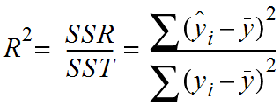
Performance Matrix
R square is used to calculate the accuracy in regression

Slide 15
Results from Model

Slide 16

Conclusion
From the plots, we can infer that Auto Encoder and Random Forest have similar performance. Auto encoder model performs relatively better than other model . In general, for our dataset, it was observed that Liner Regression performed rather
poorly than was expected. We have still not been able to deduce the reason for the same. As there was lot of class imbalance. And we need to get the important factors which are influencing growth rate so random forest is better compare to auto encoders
BEST CLASSIFIER: Random Forest with accuracy of 89.9%

Slide 17
Future Scope
Ensemble of Models
Class Imbalance
Over Sampling
Under Sampling
Feature Selection

Slide 18
Thank You

